Slide 1
3413ICT Network Security
Lecture 2A: Public-Key Cryptography & Authentication
Dr V. Muthukkumarasamy
B.Sc.Eng (Hons) (Peradeniya), PhD (Cantab), MIEE, MIEEE
Notes:
Griffith University, School of ICT
2010/1
3400ICT Information System Security
1

Slide 2
Previous Lecture..
We have studied:
Block ciphers and stream ciphers
DES & AES
Using symmetric encryption to protect confidentiality
Key distribution
Stream ciphers
Random number generation

Slide 3
Today’s Objectives
To understand the operation of public-key cryptography
To learn public-key distribution mechanism
To learn RSA and ECC
To learn the Diffie-Hellman key exchange mechanism
To study Message Authentication Codes (MAC)

Slide 4
References
Cryptography and Network Security: Principles and Practice, 6th ed.,
William Stallings, Chapters 9 and 10
Applied Cryptography, 2nd ed., Bruce Schneier: Chapters 19 and 22

Slide 5
Why New Cryptography?
We have advanced cryptography and encryption standards, such as AES
They are robust and secure in terms of data confidentiality
However, we also want to address the issues:
Key distribution – secure communications of secret keys without having to trust a KDC
Digital signatures – verifying that a message comes from the claimed sender
Notes:
The idea of public key schemes, and the first practical scheme, which was for key distribution only, was published in 1977 by Diffie & Hellman. The concept had been previously described in a classified report in 1970 by James Ellis (UK CESG) - and subsequently declassified in 1987. See History of Non-secret Encryption (at CESG). Its interesting to note that they discovered RSA first, then Diffie-Hellman, opposite to the order of public discovery!

Slide 6


Public-Key Cryptography
In 1976, Diffie and Hellman achieved an astounding breakthrough in cryptography – public-key scheme (which was probably most significant advance in the 4000 year history of cryptography)
Uses two keys – a public & a private key
Clever applications of some mathematics concepts
It complements (rather than replaces) private-key cryptography
Whitfield Diffie
Martin Hellman
Notes:
Will now discuss the radically different public key systems, in which two keys are used. Anyone knowing the public key can encrypt messages or verify signatures, but cannot decrypt messages or create signatures, counter-intuitive though this may seem. It works by the clever use of number theory problems that are easy one way but hard the other. Note that public key schemes are neither more secure than private key (security depends on the key size for both), nor do they replace private key schemes (they are too slow to do so), rather they complement them.

Slide 7
Public-Key Cryptography
Public-key/two-key/asymmetric cryptography involves the use of two keys:
Public-key, which may be known by anybody, and can be used to encrypt messages (and verify signatures)
Private-key, known only to the recipient, used to decrypt messages (and create signatures)
Asymmetric because those who encrypt messages cannot decrypt messages with the encryption key

Slide 8
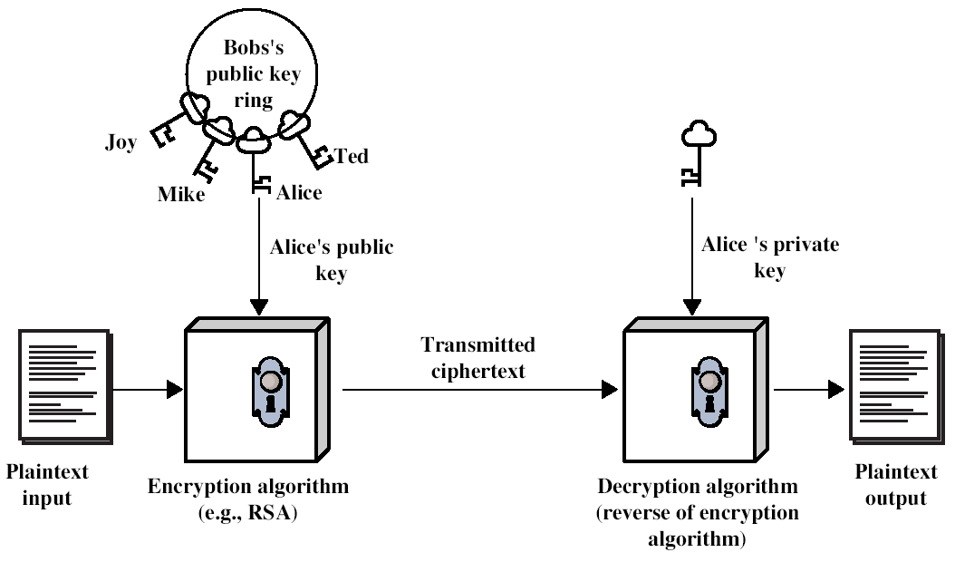
Public-Key Encryption
(Stallings Fig 9.1a)
Notes:
Stallings Fig 9.1

Slide 9
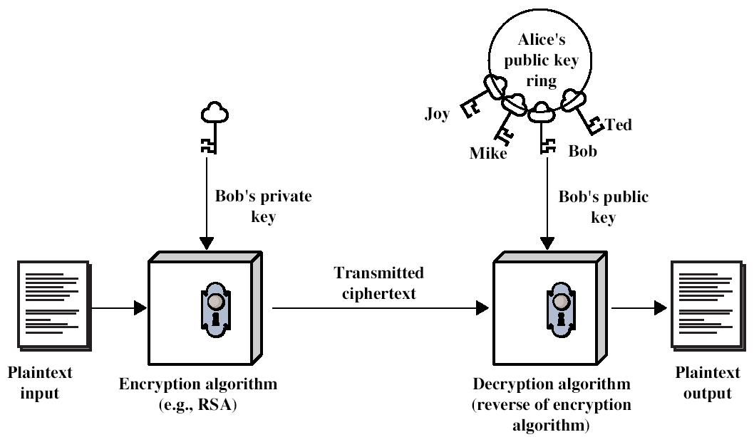
Public-Key Authentication
(Stallings Fig 9.1b)

Slide 10
Public-Key Crypto. Applications
It can be applied to:
Encryption/decryption (for confidentiality)
Digital signatures (for authentication)
Key exchange (of session keys)
Some algorithms are suitable for all uses, others are specific to one

Slide 11
Public-Key Characteristics
Public-Key algorithms rely on two critical characteristics
It is computationally infeasible to find the private key, only knowing the algorithm & public key
It is computationally easy to en/decrypt messages, when the relevant (en/decrypt) key is known
Notes:
Public key schemes utilise problems that are easy (P type) one way but hard (NP type) the other way, eg exponentiation vs logs, multiplication vs factoring. Consider the following analogy using padlocked boxes: traditional schemes involve the sender putting a message in a box and locking it, sending that to the receiver, and somehow securely also sending them the key to unlock the box. The radical advance in public key schemes was to turn this around, the receiver sends an unlocked box to the sender, who puts the message in the box and locks it (easy - and having locked it cannot get at the message), and sends the locked box to the receiver who can unlock it (also easy), having the key. An attacker would have to pick the lock on the box (hard).

Slide 12
Security of Public-Key Schemes
Like private-key cryptography, for public-key schemes, brute-force attack can be very difficult, due to large keys ( of > 512 bits) used
Security relies on a basic idea – to make it easy to en/decrypt the message, but hard to cryptanalyse
Mathematical tools make the idea possible – for examples, hard mathematical problems and one-way functions (e.g., factorizing large integers)
Notes:
Public key schemes are no more or less secure than private key schemes - in both cases the size of the key determines the security. Note also that you can't compare key sizes - a 64-bit private key scheme has very roughly similar security to a 512-bit RSA - both could be broken given sufficient resources. But with public key schemes at least there's usually a firmer theoretical basis for determining the security since its based on well-known and well studied number theory problems.

Slide 13
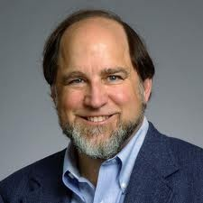
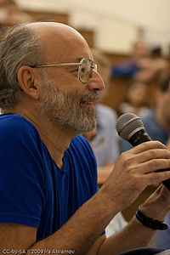
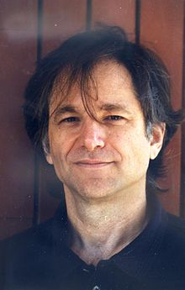
RSA Algorithm
RSA was proposed by Rivest, Shamir & Adleman, in 1977
It is best known & widely used public-key cryptography
Uses large integers (e.g. 1024 bits)
Security due to cost of factorizing large integers
Ronald Rivest
Adi Shamir
Leonard Adleman
Notes:
RSA is the best known, and by far the most widely used general public key encryption algorithm.

Slide 14
RSA – Key Generation
The ingredients are the following:
p, q, two prime numbers (private, chosen)
n=pq (public, calculated)
φ(n)=(p-1)(q-1) (private, calculated)
e with gcd(φ(n),e)=1 (public, chosen)
d= e⁻¹mod φ(n) (private, calculated)
Public key KU={e,n}
Private key KR={d, n}

Slide 15
RSA Encryption / Decryption
RSA Algorithm
For plaintext M, the encryption / decryption are as follows:

Slide 16
RSA – Mathematics Basis
Euler’s Theorem: For any integers a and n that are relatively prime
Theorem: For any two prime numbers p and q, and integers n=pq and m with 0<m<n
for any integer l.

Slide 17
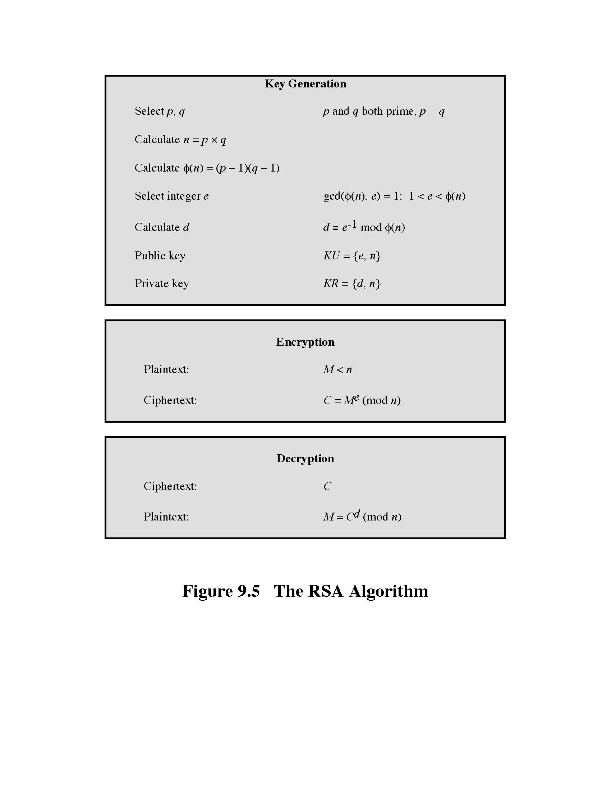
RSA Algorithm

Slide 18
RSA Example
Select primes: p=17 & q=11
Compute n = pq =17×11=187
Compute ø(n)=(p–1)(q-1)=16×10=160
Select e: gcd(e,160)=1; choose e=7
Determine d: de=1 mod 160 and d < 160 Value is d=23 since 23×7=161= 1×160+1
Publish public key KU={7,187}
Keep secret private key KR={23,187}
Notes:
Here walk through example using “trivial” sized numbers.
Selecting primes requires the use of primality tests.
Finding d as inverse of e mod ø(n) requires use of Inverse algorithm (see Ch4)

Slide 19
RSA Example (Cont…)
RSA encryption/decryption will be
Given message M = 88
Encryption:
C = 88⁷ mod 187 = 11
Decryption:
M = 11²³ mod 187 = 88
Notes:
Rather than having to laborious repeatedly multiply, can use the "square and multiply" algorithm with modulo reductions to implement all exponentiations quickly and efficiently (see next).

Slide 20
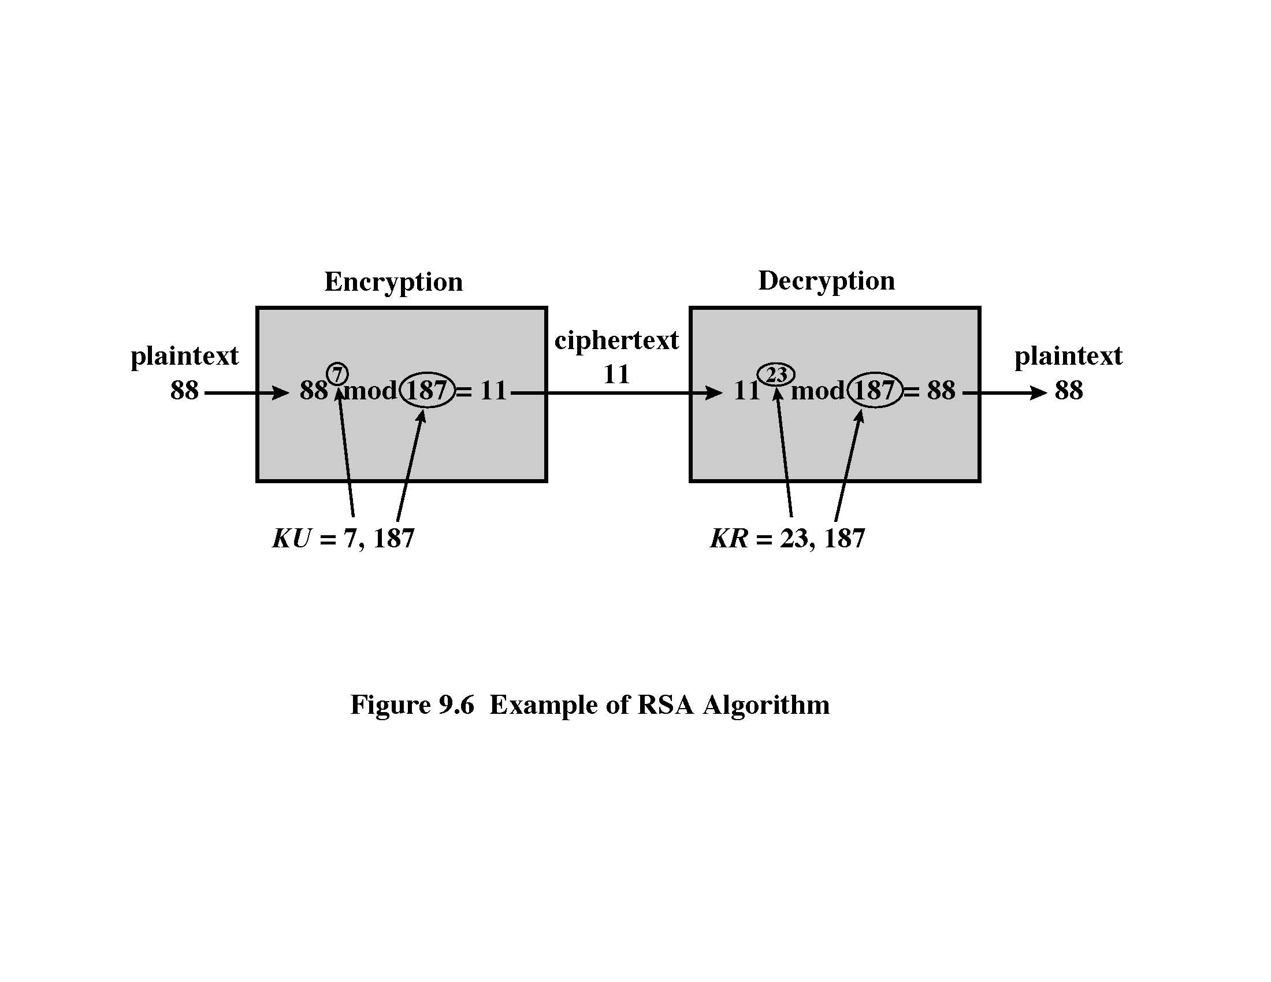
RSA Example (Cont…)

Slide 21
RSA Security
Some approaches to attacking RSA
Brute force key search – it is infeasible given size of numbers
Mathematical attacks, factorizing the integer n – it is difficult

Slide 22
Mathematical Attacks on RSA
Mathematical attacks are based on the following idea:
Computing the private key from the public key
Public key: KU={e, n} / private key: KR={d, n}
Need to get d from e
e and d satisfy: ed = 1 mod φ(n), where
n=pq and φ(n)=(p-1)(q-1)
So it requires to compute p and q, from n.
The problem of calculating p and q from n (that is, factorizing n) is a HARD problem

Slide 23
Key Distribution
Public-key encryption helps to address key distribution problems
It has two aspects:
Distribution of public keys
Use of public-key encryption to distribute secret keys

Slide 24
Distribution of Public Keys exam question
Usually use one of the followings:
Public announcement
Publicly available directory
Public-key authority
Public-key certificates

Slide 25
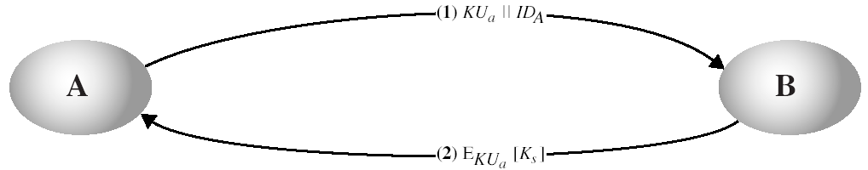
Simple Secret Key Distribution
Proposed in 1979 (Diffie, Hellman, and Merkle)
A generates a new temporary pair of public/private keys
A sends B the public key and his identity
B generates a session key K, encrypts it using the supplied public key, and then sends the encrypted key to A
A decrypts the ciphertext using the private key, and gets the key K

Slide 26
Diffie-Hellman Key Exchange
A public-key distribution scheme can help to establish a common key known only to the two participants
Diffie-Hellman scheme of key exchange
Key exchange is implemented by operations over a finite field (or called Galois field)
Security relies on the difficulty of computing discrete logarithms (similar to factoring)
– It is hard

Slide 27
Diffie-Hellman Setup
All users agree on global parameters:
Large prime integer or polynomial q
α a primitive root mod q
Each user (e.g. A) generates their key:
Chooses a secret key (number): x_{A} < q
Compute their public key: y_{A} = α^{xA} mod q
Each user then makes public that key y_{A}
Notes:
The prime q and primitive root α can be common to all using some instance of the D-H scheme. Note that the primitive root α is a number whose powers successively generate all the elements mod q. Alice and Bob choose random secrets x's, and then "protect" them using exponentiation to create the y's. For an attacker monitoring the exchange of the y's to recover either of the x's, they'd need to solve the discrete logarithm problem, which is hard.

Slide 28
Diffie-Hellman Key Exchange
Shared session key for users A & B is K_{AB}:
K_{AB} = α^{xAxB} mod q
= y_{A}^{xB} mod q (which B can compute)
= y_{B}^{xA} mod q (which A can compute)
K_{AB} is used as a key in private-key encryption scheme between A and B
Attacker needs an x, must compute discrete logarithm – It is a hard problem
Notes:
The actual key exchange for either party consists of raising the others "public key' to power of their private key. The resulting number (or as much of as is necessary) is used as the key for a block cipher or other private key scheme. For an attacker to obtain the same value they need at least one of the secret numbers, which means solving a discrete log, which is computationally infeasible given large enough numbers

Slide 29
Diffie-Hellman Example
Users Alice & Bob who wish to swap keys
Agree on prime q=353 and α=3
Select random secret keys:
A chooses x_{A}=97, B chooses x_{B}=233
Compute public keys:
y_{A}=3⁹⁷ mod 353 = 40 (Alice)
y_{B}=3²³³ mod 353 = 248 (Bob)
Compute shared session key as:
K_{AB}= y_{B}^{xA} mod 353 = 248⁹⁷ = 160 (Alice)
K_{AB}= y_{A}^{xB} mod 353 = 40²³³ = 160 (Bob)

Slide 30
Elliptic Curve Cryptography (ECC)
RSA and D-H use integer (or polynomial) arithmetic with very large numbers (or polynomials)
Imposes a significant load in storing and processing keys and messages
An alternative is to use elliptic curves
Offers same security with smaller block sizes

Slide 31
Elliptic Curves
An elliptic curve is defined by an equation in two variables x & y
An example:
y² = x³ + ax + b
where a, b are known coefficients
There is an addition operation for points on elliptic curve
This operation is used to encryption & decryption
Notes:
Griffith University, School of Information Technology
2010/1
7501ICT Information Security
31
See text for detailed rules of addition and relation to zero point O. Can derive an algebraic interpretation of addition, based on computing gradient of tangent and then solving for intersection with curve. This is what is used in practice.

Slide 32
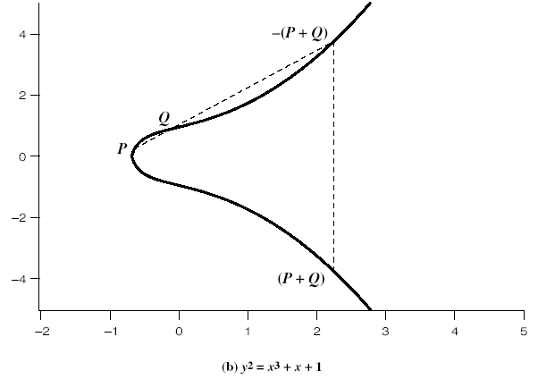
Elliptic Curve Example

Slide 33
ECC Encryption/Decryption
First, represent a message M as a point on the elliptic curve, namely, P_{m}
Select suitable point G on the curve
Each user, say, A, chooses a private key, say, n_{A}
Then, computes the public key P_{A}=n_{A}G
Encrypt P_{m} :
C_{m}={kG, P_{m}+kP_{B}}, where k is random
Decrypt C_{m}:
P_{m}+kP_{B}–n_{B}(kG) = P_{m}+k(n_{B}G)–n_{B}(kG) = P_{m}
Notes:
Several approaches to encryption/decryption using elliptic curves have been analyzed in the literature. This one is an analog of the ElGamal public-key encryption algorithm. The sender must first encode any message M as a point on the elliptic curve P_{m} (there are relatively straightforward techniques for this). Note that the ciphertext is a pair of points on the elliptic curve. The sender masks the message using random k, but also sends along a “clue” allowing the receiver who know the private-key to recover k and hence the message. For an attacker to recover the message, the attacker would have to compute k given G and kG, which is assumed hard.

Slide 34
ECC Security
Easy and hard problems with elliptic curves
For Q=kP, where Q, P belong to an elliptic curve
It is easy to compute Q, given k and P
It is hard to find k given Q and P
The hard problem is known as the elliptic curve logarithm problem

Slide 35
ECC v.s. RSA
To achieve a same level of security, ECC uses shorter keys:
RSA (key size in bits) | ECC (key size in bits)
512 | 112
1024 | 160
2048 | 224
3072 | 256
7680 | 384
15360 | 512

Slide 36
Message Authentication
Message authentication is concerned with
Protecting the integrity of a message
Validating the identity of the originator
Non-repudiation of origin
Then three alternative functions used:
Message encryption
Message authentication code (MAC)
Hash function.
Notes:
Up till now, have been concerned with protecting message content (ie secrecy) by encrypting the message. Will now consider how to protect message integrity (ie protection from modification), as well as confirming the identity of the sender. Generically this is the problem of message authentication, and in eCommerce applications is arguably more important than secrecy.

Slide 37
Message Authentication Code (MAC)
Generated by an algorithm that creates a small fixed-sized block
Depending on both message and a key
Like encryption (though need not be reversible)
Appended to message, which is called a MAC
Receiver performs same computation on message and checks whether it matches the MAC
Provides assurance that message is unaltered and comes from sender

Slide 38
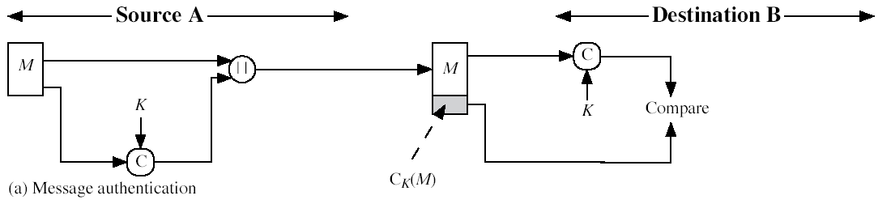
Message Authentication Code

Slide 39
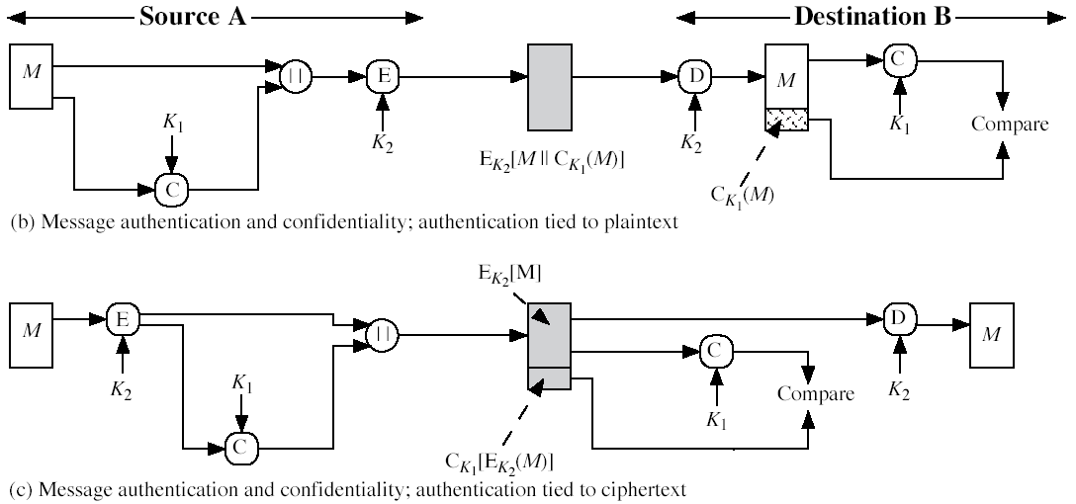
Message Authentication Codes
Can also use encryption for secrecy [exam question, make sure you can draw diagrams]
Generally use separate keys for each
Can compute MAC either before or after encryption, but is generally regarded as better done before

Slide 40
MAC Properties
A MAC is a cryptographic checksum
MAC = C_{K}(M)
Condenses a variable-length message M
Using a secret key K
To a fixed-sized code
Is a many-to-one function:
Potentially many messages have same MAC
But finding these is very difficult

Slide 41
Requirements for MACs
To make it secure enough, the MAC should satisfy the following:
Knowing a message and MAC, is infeasible to find another message with same MAC
MACs should be uniformly distributed
MAC should depend equally on all bits of the message

Slide 42
Summary
Have considered:
Public-key cryptography
RSA, including algorithm and security
Distribution of public keys
Public-key distribution of secret keys
Diffie-Hellman key exchange
Elliptic Curve cryptography
Message Authentication Codes

Slide 43
Next Lecture…
Authentication…

Slide 44

Questions?

